Slide 1

Pharmacokinetics of Levodopa in Parkinson’s Disease (PD)
Cam Lunn¹ and Will Wright²
¹Complex Systems and Data Science, ²Department of Electrical and Biomedical Engineering

Slide 2
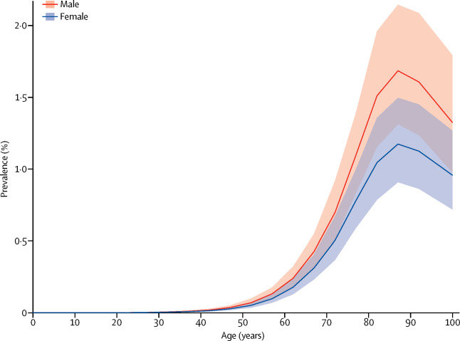
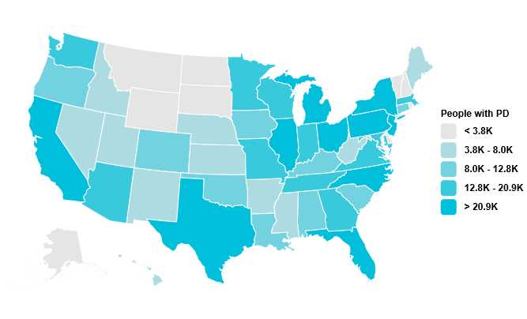
PD statistics
General:
2nd most common neurodegenerative disorder.
1,000,000 individuals living with PD in the US
$52 billion in economic burden
Risk Factors:
Exposures to chemicals, pesticides, industrial products
Age
Sex
Familial history

Slide 3
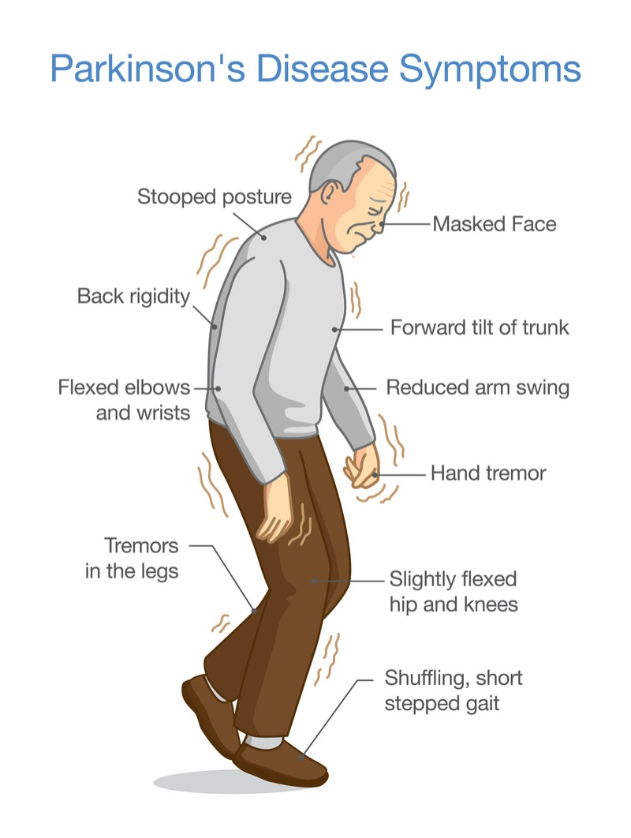
Symptoms, Diagnosis, and prognosis
Asymptomatic in early stages
Clinical diagnosis (bradykinesia)
Imaging (DaTscans) as a confirmatory strategy
Symptoms worsen with age
Pathology associated with neurodegeneration and loss of motor function

Slide 4
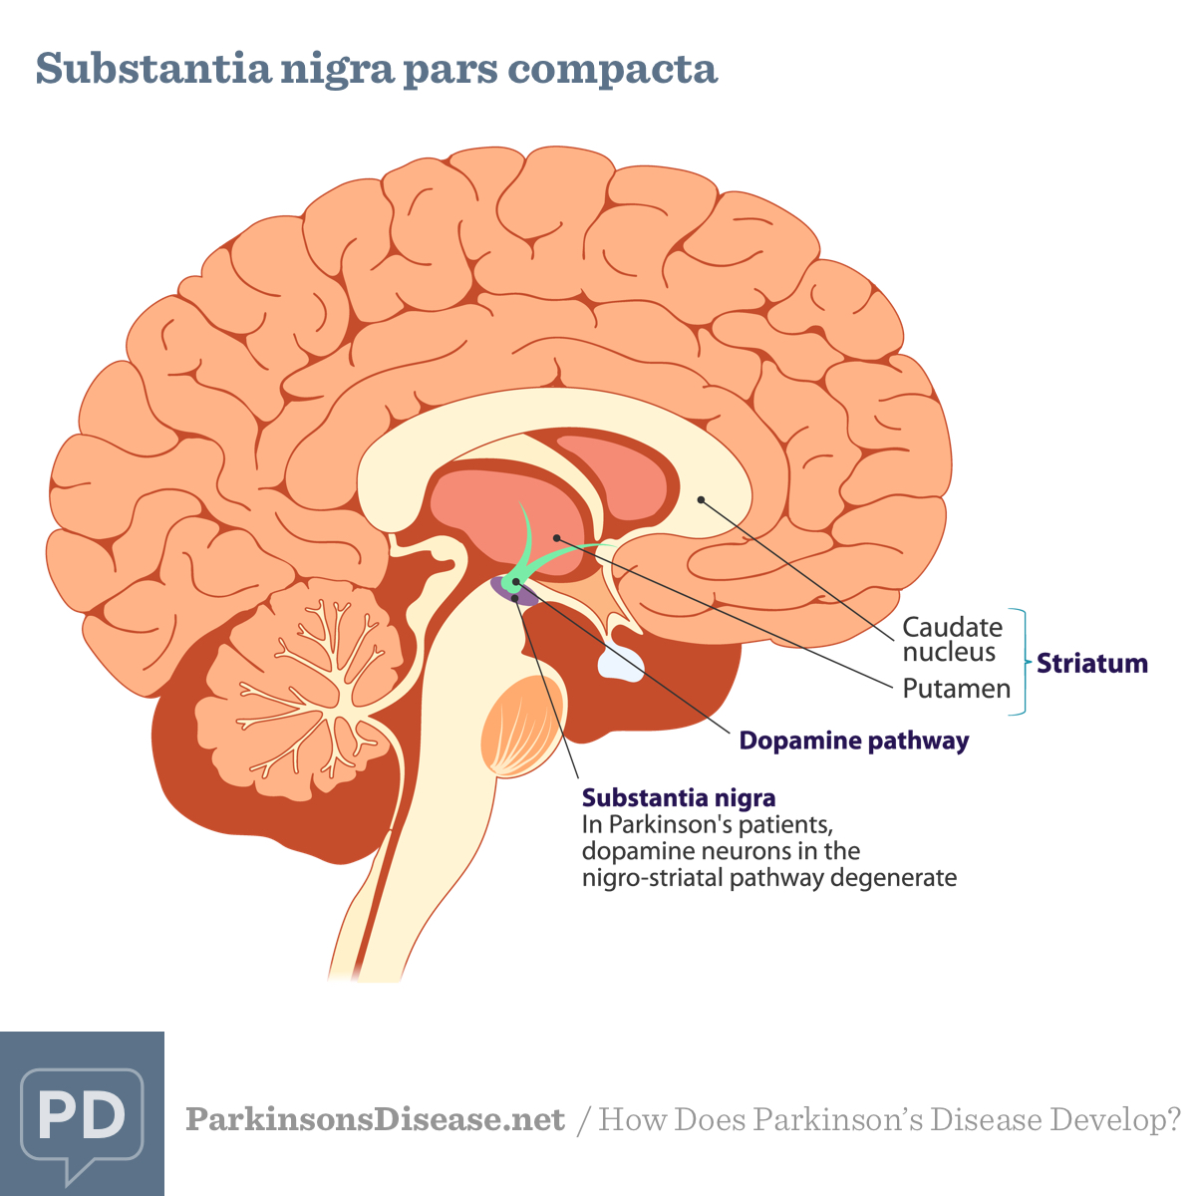
Pathology
Dopamine is the interneuron communicator between basal ganglia and substantia nigra
Threshold of 70-80% neuronal loss leads to adverse symptoms
Loss of motor function

Slide 5
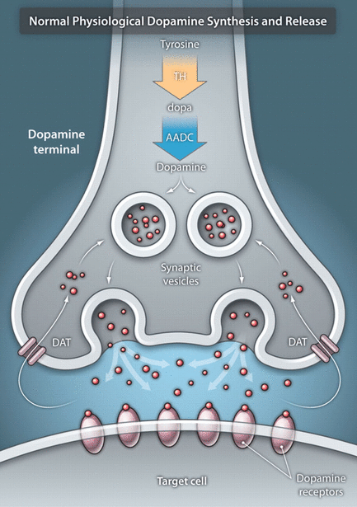
Treatment
Dopamine replacement therapy (DRT)
Dopamine is highly polar – can cross BBB alone
Requires precursor levodopa molecule
Rytary and Sinemet

Slide 6
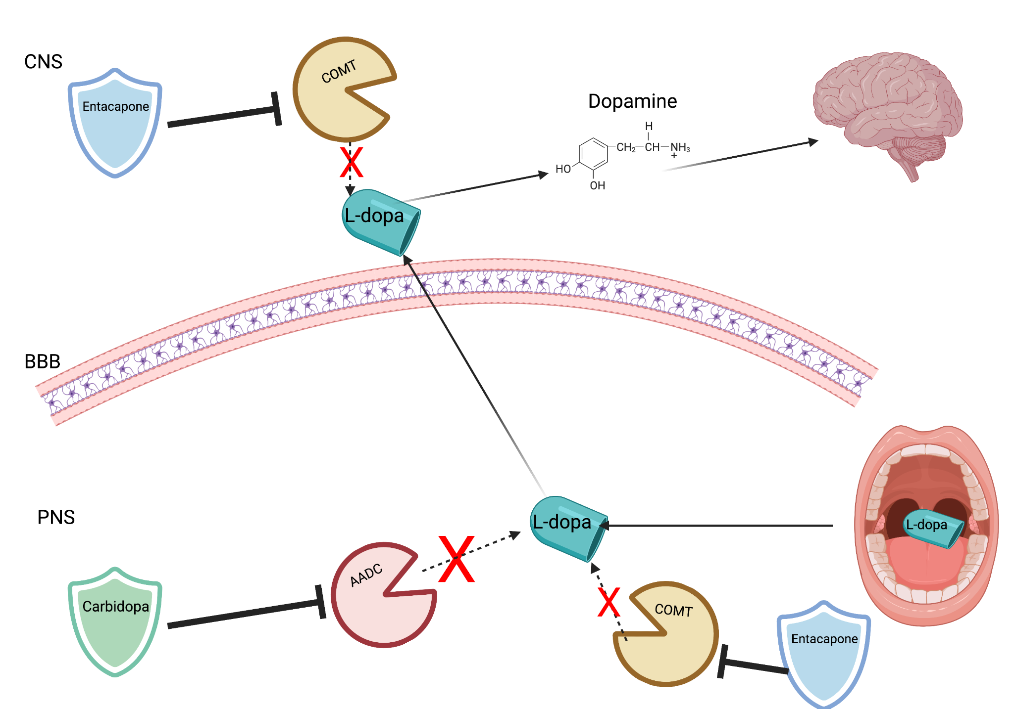
Dopamine Replacement Therapy

Slide 7
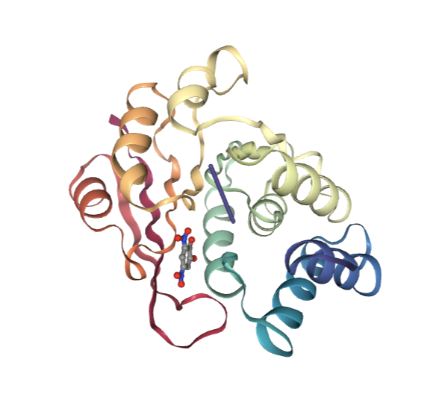
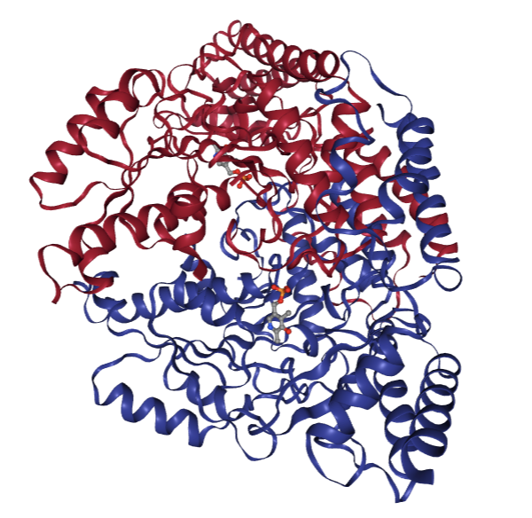
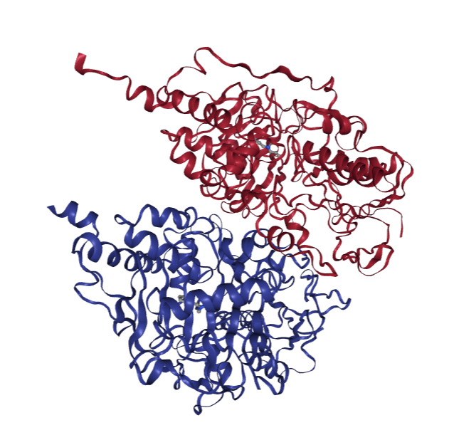
Alphafold
COMT
AADC
MAO-B
Catechol O-methyltransferase
Aromatic L-Amino acid Dopa Decarboxylase
Monoamine Oxidase B
(Entacapone)
(Carbidopa)
(Selegiline)

Slide 8
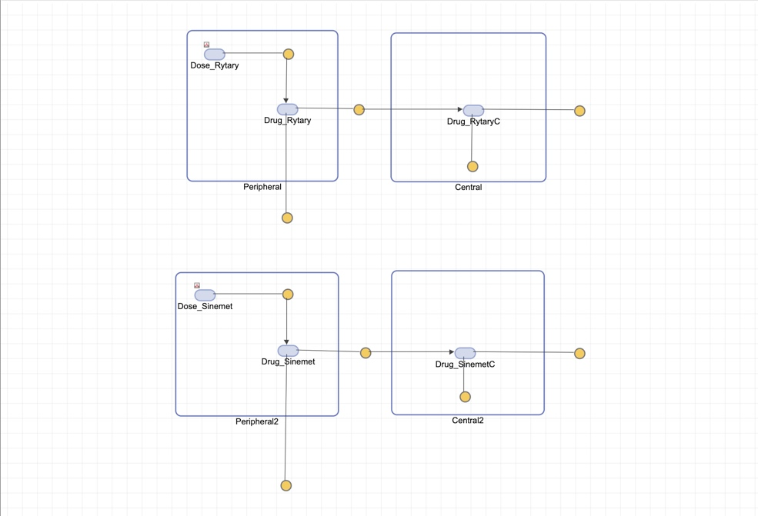
Rytary and Sinemet
Notes:
Models use linear mass-action kinetics, that depend on reaction rates and concentrations. The rate of a reaction is proportional to the chemical activities of the reactants involved, where the chemical activity depends on concentrations.
the rate of a reaction is proportional to the chemical activities of the reactants involved, where the chemical activity depends on concentrations

Slide 9
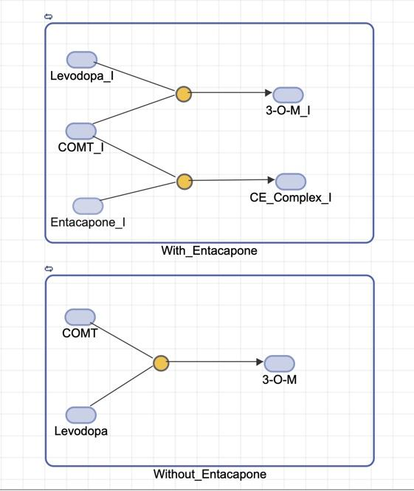
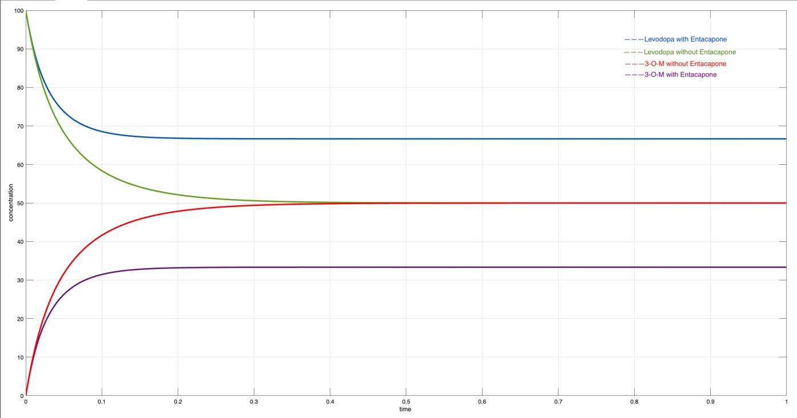
Enzymatic reaction of levodopa, COMT, and COMT inhibitor (Entacapone)
Notes:
catechol-O-methyltransferase

Slide 10
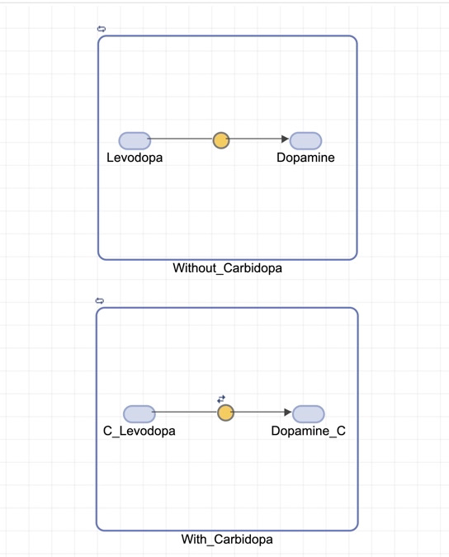
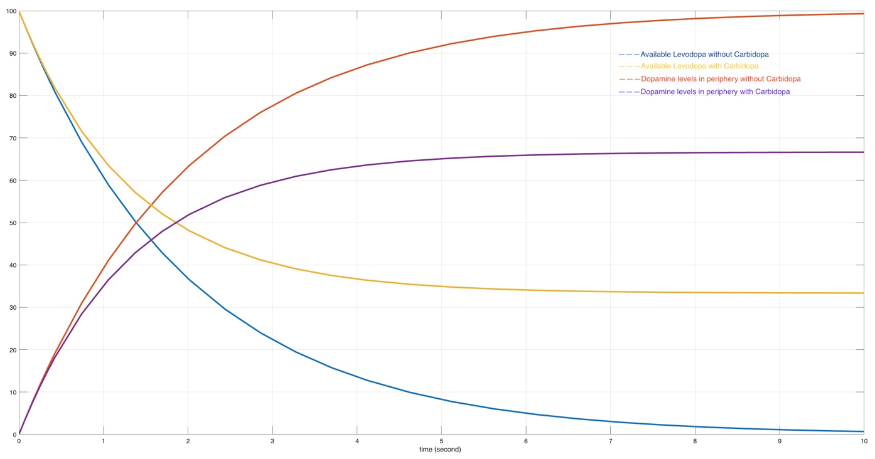
Biosynthesis/Inhibition of Dopamine
(With and without carbidopa)

Slide 11
Rytary and Sinemet

Slide 12
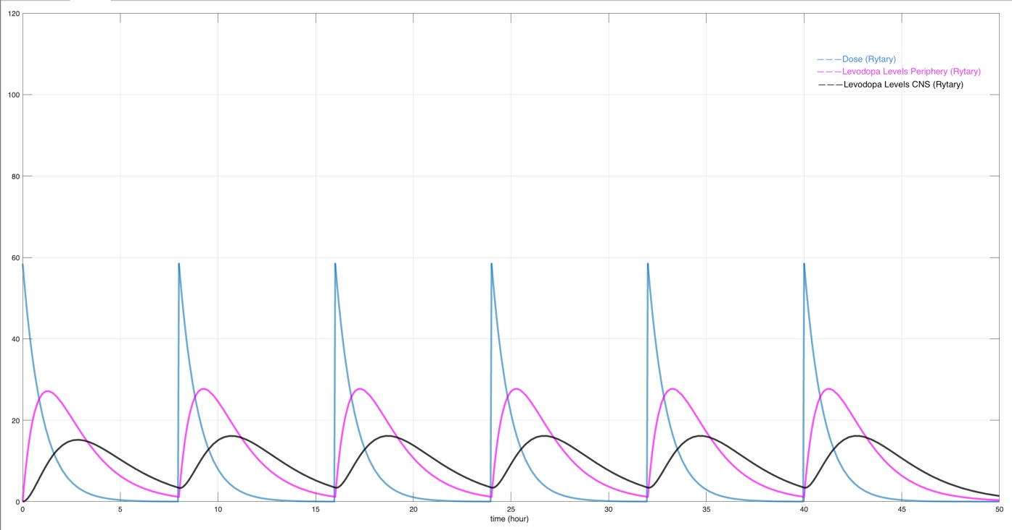
Rytary Dosing

Slide 13
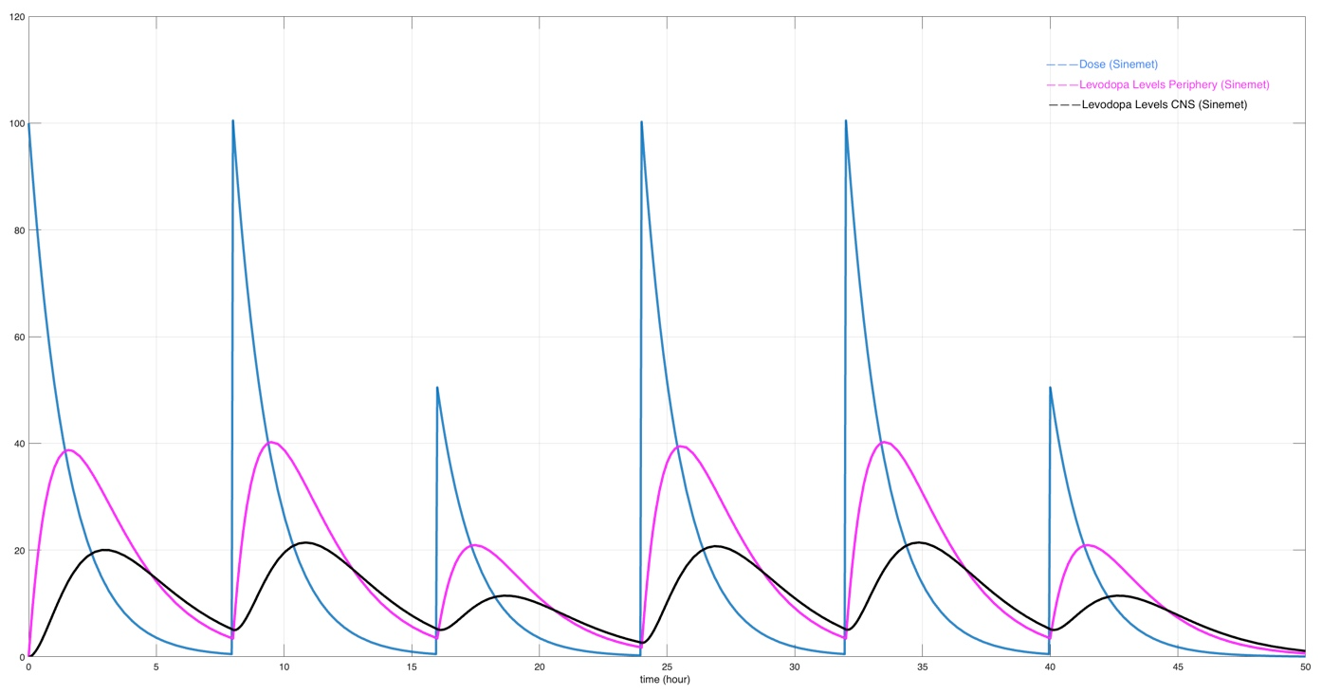
Sinemet Dosing

Slide 14
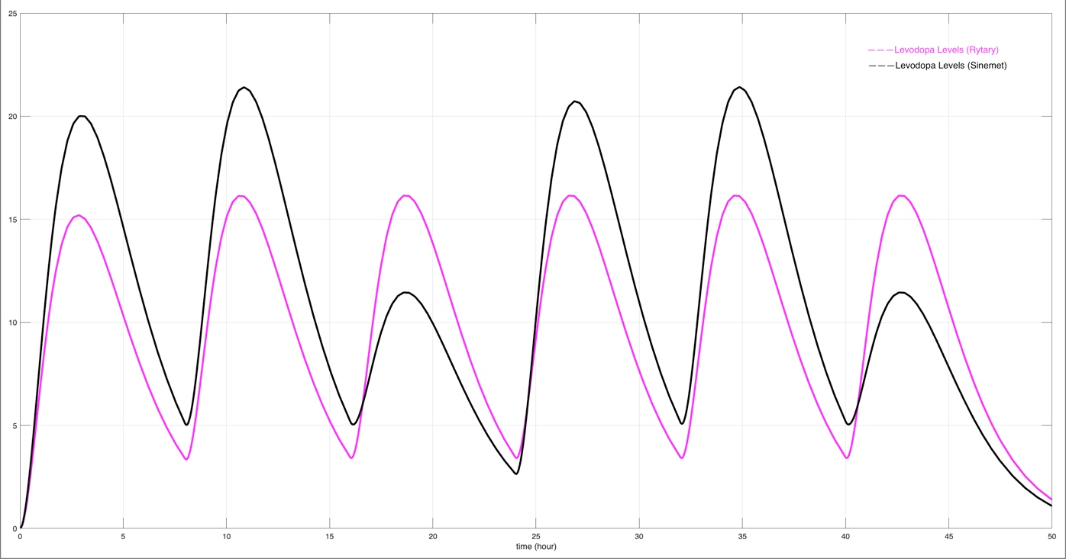
Rytary vs Sinemet (CNS)

Slide 15
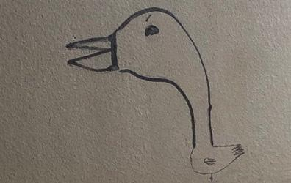
Discussion
Findings:
Optimization potential
Clinical relevance
Future Directions:
Considering other components in the L-dopa pathway
i.e. Transporter proteins (OCT1, SLC22A1, etc.)
MAO-B proteins (Inhibitors)
Mutations
Notes:
Integration missing, peak, fluctuation, lower limit (bedtime), elimination rate, 500 mg versus the 351 mg, MM kinetics
at very lower concentrations, the rate of the enzyme is directly proportional to the concentration of substrate; conversely, at very high concentrations, the rate at which the enzyme operates approaches a maximum quantity called maximum velocity.
The equation tells us that at very lower concentrations, the rate of the enzyme is directly proportional to the concentration of substrate; conversely, at very high concentrations, the rate at which the enzyme operates approaches a maximum quantity called maximum velocity.

Slide 16
References
1. Statistics. (n.d.). Parkinson’s Foundation. https://www.parkinson.org/understanding-parkinsons/statistics
2. Parkinson’s Disease – Symptoms, Diagnosis and Treatment. (n.d.). https://www.aans.org/en/Patients/Neurosurgical-Conditions-and-Treatments/Parkinsons-Disease
3. Lampropoulos, I., Malli, F., Sinani, O., Gourgoulianis, K. I., & Xiromerisiou, G. (2022). Worldwide trends in mortality related to Parkinson’s disease in the period of 1994–2019: Analysis of vital registration data from the WHO Mortality Database. Frontiers in Neurology, 13. https://doi.org/10.3389/fneur.2022.956440
4. Dorsey, E. R., Elbaz, A., Nichols, E., Abd-Allah, F., Abdelalim, A. A., Adsuar, J. C., Ansha, M. G., Brayne, C., Choi, J. J., Collado-Mateo, D., Dahodwala, N., Phuc, H., DO, Edessa, D., Endres, M., Fereshtehnejad, S., Foreman, K. J., Gankpé, F. G., Gupta, R., Hankey, G. J., . . . Murray, C. J. L. (2018). Global, regional, and national burden of Parkinson’s disease, 1990–2016: a systematic analysis for the Global Burden of Disease Study 2016. Lancet Neurology, 17(11), 939–953. https://doi.org/10.1016/s1474-4422(18)30295-3
5. Feigin, V. L., Abajobir, A. A., Abate, K. H., Abd-Allah, F., Abdulle, A. M., Abera, S. F., Abyu, G. Y., Ahmed, M. B., Aichour, A. N., Aichour, I., Aichour, M. T. E., Akinyemi, R., Alabed, S., Al-Raddadi, R., Alvis-Guzman, N., Amare, A. T., Ansari, H., Anwari, P., Ärnlöv, J., . . . Disorders, G. N. (2017). Global, regional, and national burden of neurological disorders during 1990–2015: a systematic analysis for the Global Burden of Disease Study 2015. Lancet Neurology, 16(11), 877–897. https://doi.org/10.1016/s1474-4422(17)30299-5
6. Willis, A. W., Roberts, E., Beck, J. D., Fiske, B. K., Ross, W., Savica, R., Van Den Eeden, S. K., Tanner, C. M., Marras, C., Alcalay, R., Schwarzschild, M., Racette, B., Chen, H., Church, T., Wilson, B., & Doria, J. M. (2022). Incidence of Parkinson disease in North America. Npj Parkinson’s Disease, 8(1). https://doi.org/10.1038/s41531-022-00410-y
7. Yang, W., Hamilton, J. L., Kopil, C., Beck, J. D., Tanner, C. M., Albin, R. L., Dorsey, E. R., Dahodwala, N., Cintina, I., Hogan, P. F., & Thompson, T. (2020). Current and projected future economic burden of Parkinson’s disease in the U.S. NPJ Parkinson’s Disease, 6(1). https://doi.org/10.1038/s41531-020-0117-1
8. Pringsheim, T., Jette, N., Frolkis, A. D., & Steeves, T. (2014). The prevalence of Parkinson’s disease: A systematic review and meta-analysis. Movement Disorders, 29(13), 1583–1590. https://doi.org/10.1002/mds.25945
9. The National Council on Aging. (n.d.). https://www.ncoa.org/article/parkinsons-disease-early-signs-symptoms-and-what-to-do-when-diagnosed
10. Berardelli, A., Rothwell, J., Thompson, P. D., & Hallett, M. (2001). Pathophysiology of bradykinesia in Parkinson’s disease. Brain, 124(11), 2131–2146. https://doi.org/10.1093/brain/124.11.2131
11. Reichmann, H. (2010). Clinical Criteria for the Diagnosis of Parkinson’s Disease. Neurodegenerative Diseases, 7(5), 284–290. https://doi.org/10.1159/000314478
12. Getting Diagnosed. (n.d.). Parkinson’s Foundation. https://www.parkinson.org/understanding-parkinsons/getting-diagnosed
13. Gilbert, R. (2022). What is a DaTscan and should I get one? American Parkinson Disease Association. https://www.apdaparkinson.org/article/what-is-a-datscan-and-should-i-get-one/
14. Triarhou, L. C. (2013). Dopamine and Parkinson’s Disease. Madame Curie Bioscience Database - NCBI Bookshelf. https://www.ncbi.nlm.nih.gov/books/NBK6271/
15. Pickel, V. M., Beckley, S., Joh, T. H., & Reis, D. J. (1981). Ultrastructural immunocytochemical localization of tyrosine hydroxylase in the neostriatum. Brain Research, 225(2), 373–385. https://doi.org/10.1016/0006-8993(81)90843-x
16. Freund, T. F., Powell, J., & Smith, A. D. (1984). Tyrosine hydroxylase-immunoreactive boutons in synaptic contact with identified striatonigral neurons, with particular reference to dendritic spines. Neuroscience, 13(4), 1189–1215. https://doi.org/10.1016/0306-4522(84)90294-x
17. El-Agnaf, O. M. A., Salem, A. Z., Paleologou, K. E., Curran, M. D., Gibson, M. A., Court, J. A., Schlossmacher, M. G., & Allsop, D. (2006). Detection of oligomeric forms of α‐synuclein protein in human plasma as a potential biomarker for Parkinson’s disease. The FASEB Journal, 20(3), 419–425. https://doi.org/10.1096/fj.03-1449com
18. Ferrazzoli, D., Carter, A., Ustun, F. S., Palamara, G., Ortelli, P., Maestri, R., Yücel, M., & Frazzitta, G. (2016). Dopamine Replacement Therapy, Learning and Reward Prediction in Parkinson’s Disease: Implications for Rehabilitation. Frontiers in Behavioral Neuroscience, 10. https://doi.org/10.3389/fnbeh.2016.00121
19. M Burnham, P., & Gregory, S. (2008, October). Dopamine - Molecule of the Month October 2008 - HTML-only version. http://www.chm.bris.ac.uk/motm/dopamine/dopamineh.htm#:~:text=This%20is%20because%20the%20dopamine,contains%20the%20chemical%20L%2Ddopa.
20. Pringsheim, T., Day, G. S., Smith, D., Rae-Grant, A., Licking, N., Armstrong, M. J., De Bie, R. A., Roze, E., Miyasaki, J. M., Hauser, R. A., Espay, A. J., Martello, J., Gurwell, J. A., Billinghurst, L., Sullivan, K. L., Fitts, M. A., Cothros, N., Hall, D. A., Rafferty, M. R., . . . Lang, A. E. (2021). Dopaminergic Therapy for Motor Symptoms in Early Parkinson Disease Practice Guideline Summary. Neurology, 97(20), 942–957. https://doi.org/10.1212/wnl.0000000000012868
21. Redenšek, S., Bizjan, B. J., Trošt, M., & Dolžan, V. (2019). Clinical-Pharmacogenetic Predictive Models for Time to Occurrence of Levodopa Related Motor Complications in Parkinson’s Disease. Frontiers in Genetics, 10. https://doi.org/10.3389/fgene.2019.00461
22. Corvol, J., & Poewe, W. (2017). Pharmacogenetics of Parkinson’s Disease in Clinical Practice. Movement Disorders Clinical Practice, 4(2), 173–180. https://doi.org/10.1002/mdc3.12444
23. Dumbhare, O., & Gaurkar, S. S. (2023). A Review of Genetic and Gene Therapy for Parkinson’s Disease. Cureus. https://doi.org/10.7759/cureus.34657
24. Gandhi, K. R. (2022, May 2). Levodopa (L-Dopa). StatPearls - NCBI Bookshelf. https://www.ncbi.nlm.nih.gov/books/NBK482140/
25. Goetz, C. G. (1998). Influence of COMT inhibition on levodopa pharmacology and therapy. Neurology, 50(Issue 5, Supplement 5), S26–S30. https://doi.org/10.1212/wnl.50.5_suppl_5.s26
26. COMT Inhibitors. (n.d.). Parkinson’s Foundation. https://www.parkinson.org/living-with-parkinsons/treatment/prescription-medications/comt-inhibitors
27. Tan, Y., Jenner, P., & Chen, S. (2022). Monoamine Oxidase-B Inhibitors for the Treatment of Parkinson’s Disease: Past, Present, and Future. Journal of Parkinson’s Disease, 12(2), 477–493. https://doi.org/10.3233/jpd-212976
28. Chen, J., & Swope, D. M. (2005). Clinical Pharmacology of Rasagiline: A Novel, Second-Generation Propargylamine for the Treatment of Parkinson Disease. The Journal of Clinical Pharmacology, 45(8), 878–894. https://doi.org/10.1177/0091270005277935
29. Mazumder, M. K., Paul, R., Phukan, B. C., Dutta, A., Chakrabarty, J., Bhattacharya, P., & Borah, A. (2018). Garcinol, an effective monoamine oxidase-B inhibitor for the treatment of Parkinson’s disease. Medical Hypotheses, 117, 54–58. https://doi.org/10.1016/j.mehy.2018.06.009
30. Leyden, E. (2022, July 22). Carbidopa. StatPearls - NCBI Bookshelf. https://www.ncbi.nlm.nih.gov/books/NBK554552/#:~:text=Carbidopa%20is%20a%20medication%20used,decarboxylase%20inhibitor%20class%20of%20drugs.
31. Moore, J. J. (2022, May 2). Selegiline. StatPearls - NCBI Bookshelf. https://www.ncbi.nlm.nih.gov/books/NBK526094/
32. Parkinson’s Disease & Medications. (n.d.). Cleveland Clinic. https://my.clevelandclinic.org/health/diseases/9198-medications-for-parkinsons-disease
33. Mittur, A., Gupta, S. K., & Modi, N. B. (2017). Pharmacokinetics of Rytary®, An Extended-Release Capsule Formulation of Carbidopa–Levodopa. Clinical Pharmacokinectics, 56(9), 999–1014. https://doi.org/10.1007/s40262-017-0511-y
34. How it Works | RYTARY® (carbidopa and levodopa) extended-release capsules. (n.d.). https://rytary.com/how-rytary-is-thought-to-work
35. Margolesky, J., & Singer, C. (2018). Extended-release oral capsule of carbidopa–levodopa in Parkinson disease. Therapeutic Advances in Neurological Disorders, 11, 175628561773772. https://doi.org/10.1177/1756285617737728
36. Białecka, M., Kurzawski, M., Klodowska-Duda, G., Opala, G., Jankovic, J., & Droździk, M. (2008). The association of functional catechol-O-methyltransferase haplotypes with risk of Parkinson’s disease, levodopa treatment response, and complications. Pharmacogenetics and Genomics, 18(9), 815–821. https://doi.org/10.1097/fpc.0b013e328306c2f2
37. Cheshire, P. A., Bertram, K., Ling, H., O’Sullivan, S. S., Halliday, G. M., McLean, C., Bras, J., Foltynie, T., Storey, E., & Williams, D. R. (2013). Influence of Single Nucleotide Polymorphisms in <b><i>COMT</i></b>, <b><i>MAO-A</i></b> and <b><i>BDNF</i></b> Genes on Dyskinesias and Levodopa Use in Parkinson’s Disease. Neurodegenerative Diseases, 13(1), 24–28. https://doi.org/10.1159/000351097
38. Becker, M. L., Visser, L. E., Van Schaik, R. H., Hofman, A., Uitterlinden, A. G., & Stricker, B. H. (2011). OCT1 polymorphism is associated with response and survival time in anti-Parkinsonian drug users. Neurogenetics, 12(1), 79–82. https://doi.org/10.1007/s10048-010-0254-5

Slide 17
Images
https://stanfordmedicine25.stanford.edu/the25/parkinsondisease/_jcr_content/main/panel_builder_0/panel_0/panel_builder_0/panel_0/panel_builder/panel_0/image.img.full.high.png/1.png
https://www.researchgate.net/profile/Muhammad-Aziz-Rahman/publication/328011698/figure/fig3/AS:746265721700353@1554935021608/Global-prevalence-of-Parkinsons-disease-by-age-and-sex-2016-Prevalence-is-expressed.png
https://parkinsonsnewstoday.com/wp-content/uploads/2018/07/Causes-Statistics-Prevalence-Project.png
https://parkinsonsdisease.net/wp-content/uploads/2017/04/How-Does-Parkinson%E2%80%99s-Disease-Develop-SNPC.jpg

